Slide 1
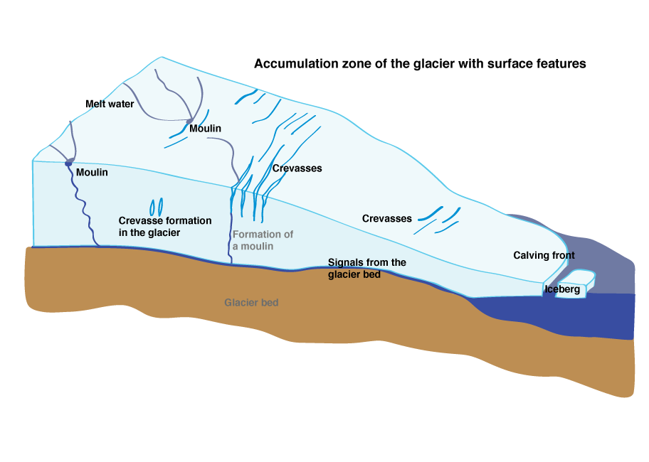
http://static.seismo.ethz.ch/interactive_images/icequakes/index_EN.html

Slide 2
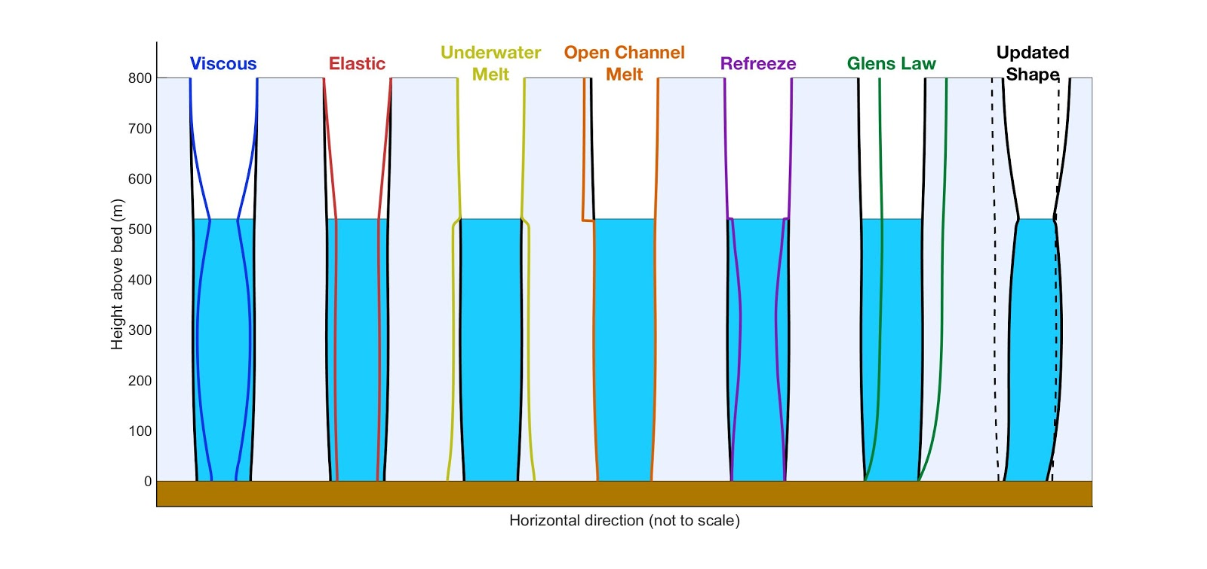

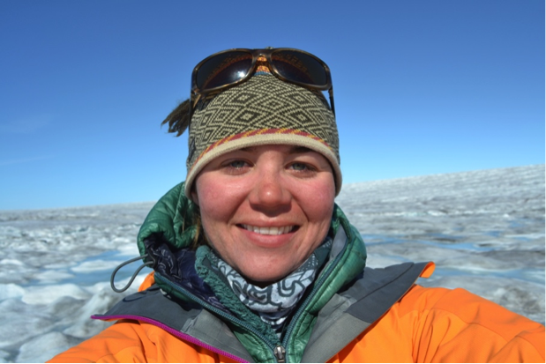
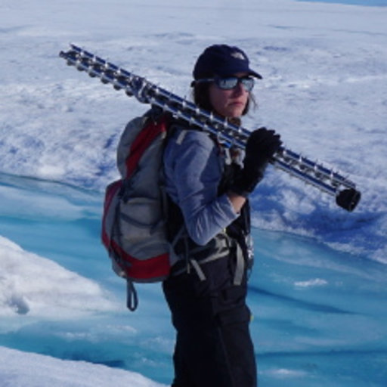
MouSh model (Moulin Shape model in matlab)
Kristin Poinar -- University at Buffalo
Lauren Andrews -- Nasa Goddard
Poinar et al., in prep
pyMouSh model (python translation of the model)
+ subglacial channel component in matlab

Slide 3
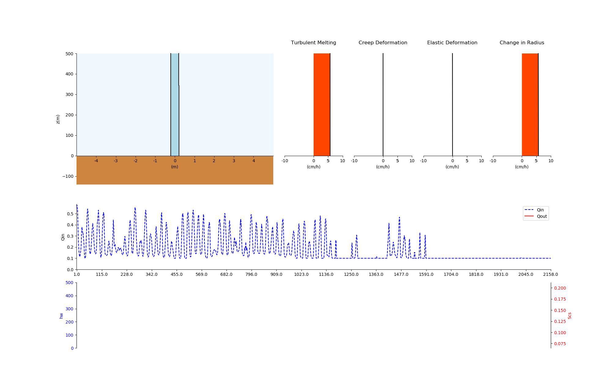
Qin
Qout

Slide 4
hw = 800 m
Tice = 0°C
Radius = 1
overburden pressure
Tice = 0°C
Radius = 1
Filled moulin
Tice = 0°C
Radius = 1

Slide 5
Temperature
Melt
Elastic deformation
Creep deformation

Slide 6
MELT
Radius
Water velocity in moulin
Qout
ELASTIC
Radius
Pw-Pi
Stress field
CREEP
Radius
Pw-Pi
Ice temperature
head
Qout
Pw

